Slide 1
Directors/Mentors

Slide 2
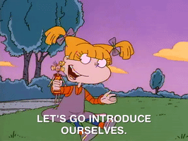
INTRODUCTIONS
Your Name and Preferred Pronouns
School You Are At
Show and Show Dates

Slide 3
AYTC Mentor…… What does that Mean??
Expectations
Assist for at least one show (at times life happens and we need to cancel our mentorship, please make sure you contact Tracy ASAP, to allow for a reasonable amount of time to find a replacement).
If you can be a mentor for more than one show, please let Tracy know
Reading and selecting top reviews, Deadlines for top submissions are usually Sunday evenings by 9:00 p.m. BUT this is negotiable
What to look for in a review. We are not as formal with what a review looks like as we used to (this will be discussed in the student's writing session with ………)
Schedule selection for mentors will come out on November 1 for the mentors as we will sort out which school team is going to which show
Most important aspect of being a mentor is allowing the students to direct the conversation (within reason)
Try to avoid talking to much as it will set the tone that you will be doing most of the talking, guide them yes but make sure they are coming to their own conclusions about what they have seen.
Make sure everyone feels heard, and the best way to accomplish this is to listen to them

Slide 4
How Should I Organize Pre/Mid/Post Show Discussions?
Plan how you will conduct the discussion.
Ideally the discussion will occur spontaneously, however, you will want to do some careful planning.
You should have a clear goal/objective for the discussion, a plan for how you will prepare the students, and a general idea about how you will guide the discussion (e.g., with background of the show they are seeing, venue (is the production facing any constraints), fun facts about the show, etc.
Establish ground rules for participation in a discussion. For a discussion to be effective, students need to understand the value of actively listening to their peers, tolerating opposing viewpoints, and being open-minded.
You might spend the first session with your students exploring the characteristics of effective and ineffective discussions. Phone away, notes out, no side chatter etc.
Clearly communicate how much time you have for questions or discussion, and what you are looking for from this time. Be mindful of time and don’t be afraid to share the responsibility with the other mentor about time keeping.
EX: “student A” you have 30 more seconds to finish that thought.
OR we will hear from new people before returning to people who have already spoken. Balance the student voices in the room.
Keep the discussion focused. Have a clear agenda for the discussion and remind everyone of where the discussion is heading. Brief interim summaries are also helpful if they don't interfere with the flow of the discussion. If the discussion gets off track, stop and bring the discussion back to the key issues.
Signs of a discussion breaking down is if potential subgroups start to form and are engaging in private conversations, members not listening to one another, or students trying to force their ideas upon the group.
If this occurs a potential solution would be to halt the conversation by posing a new question guiding the group down a different path.
Bring closure to the discussion. Announce that the discussion is ending and ask the group if there are any final comments or questions before you pull the ideas together.
While the students are discussing various topics throughout the night, as a mentor you could be taking notes so at the end you could emphasize 2-3 key points, tying the ideas into a review.
Focus on using key vocabulary or ideas from the discussion that students may use in their writing.

Slide 5
Mentors……
Allow for enough time to get to the venue and into the AYTC room
There are a lot of things students should do before going into the auditorium and sitting down
such as using the restroom, getting and finishing their snack or beverage (don’t take those snacks into the theatre!)
reading the program, allowing the critics to get into the right mindset for the show they’re about to see.
If students are rushing in at the last minute, they won’t be in the “let’s enjoy a show” mindset – they will be stressed out and distracted.
Lead by Example…….
scene changes are not for chatting
shushing others makes just as much noise as the actual noise being made
when the house manager asks to turn off cell phones, please ACTUALLY turn yours off

Slide 6
Share Edmonton’s Theatre Community with NOT ONLY your critic team but your cast and crew!
Edmonton has a vibrant theatre scene, and no matter what your budget looks like there are a plethora of ways to experience theatre in this city!
See other AYTC shows. Even if you’re not assigned to a particular show, try to see as many AYTC shows as you can! If seating is limited maybe, ask about live streaming and watch as a cast/crew
Take advantage of AYTC workshops. These workshops are offered free of charge to AYTC members. This allows for students to gain a broader community of theatre professionals as well as like-minded theatre enthusiasts.
See any of the many shows that are produced in Edmonton. Whether it’s the Citadel, local theatre companies such as Catalyst Theatre, the Fringe Festival, touring shows, local comedy at the Grindstone, Rapid Fire Theatre, or one of the many, many theatre festivals in the city.
Consider volunteering. By volunteering with theatre festivals, you’re not only providing a valuable service to an integral part of Edmonton’s artistic community; you’re on the ground floor of some of the most exciting things this city has to offer.
Just see theatre! Anywhere and Everywhere!

Slide 7
Role as a Show Director
Plan for a space to be occupied by the AYTC Group (away from the performance area)
Group will arrive about 45 minutes before show time (please have appropriate signage to guide the group or have assigned students to show them to the room)
Snacks and Beverages are completely up to the show director and the hosting AYTC team.
Have enough programs for all student critics and two mentors
Present all documentation needed for all areas of Technical Theatre
Would be wonderful if the Show Director came to speak to the AYTC critic group.
If possible, it would be wonderful to have an after-show talk back with the cast and crew (but not mandatory)
Tickets for 30 - 35 reviewers and mentors
On average we are running about 30-45 minutes post show discussion (which will include cast/crew talk back), someone from the production (teacher/mentor) should be in the building during this time.

Slide 8
Reviews will be sent to the director in a giant word document (Tracy assigns each review by random number), allowing for our critics to be anonymous until the reviews get published.
Editing is part of the job of the mentors who see the show (top 5 are chosen), however Tracy will also be looking over the reviews to make sure all names and pronouns are correct.

Slide 9
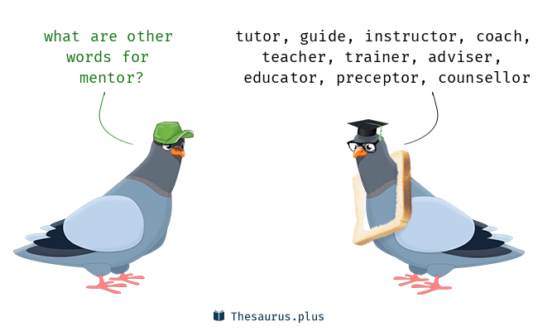
MENTORS……. Do We Like This Name??
Would we like to try a different name? THOUGHTS?
Advisor
Teacher
Coach

